Slide 1
CARIBBEAN CIVIL SOCIETY SHARED INCIDENT DATABASE
A monitoring and reporting mechanism to strengthen community activism to address human rights violations
Marlon Thompson
Shared Incident Database Coordinator
AIDS 2018, Amsterdam, 26 July 2018

Slide 2
OUTLINE
Overview
Progress to Date
Success Stories
Sustainable HIV Response
Next Steps

Slide 3
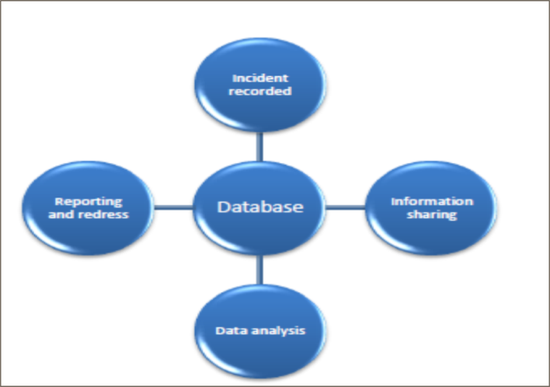
OVERVIEW
The first regional civil society-led human rights monitoring mechanism
Support and strengthen evidence based advocacy initiatives
Enables comprehensive documentation to support redress
Improve institutional capacity to document rights violations
Broker dialogue with CSOs and duty bearers
Support reporting to international reporting bodies

Slide 4
OVERVIEW
Clients identifiable details are only visible at an organizational level and there are varied data access levels within an organization profile
Governed by a steering committee user members and subject area experts
CSOs document in silos but are able to un
Support national or regional data exchange
Web based - Support real time documentation in the field
Flags possible duplicated incidents

Slide 5
PROGRESS TO DATE
28 user members from the following countries:
Jamaica, Guyana, Suriname, Belize, Dominican Republic, Haiti, St. Lucia and Barbados.
Over 1425 incidents have been documented to date (validated)
Top 5 Incident type:
Physical Violence, Breach of confidentiality, Denied access to healthcare, Forced to leave job and Discrimination against relative
12 community para-legal operating in 5 countries both as individuals and with organisations
5 legal challenges filed before the courts in Jamaica, Guyana and Trinidad & Tobago respectively

Slide 6
SUCCESS STORY
Comforting Hearts in New Amsterdam, Guyana
They work with persons living with HIV
No official client complaint mechanism for the health care sector in New Amsterdam
Shared Incident Database has proven to be viable substitute

Slide 7
SUSTAINABLE HIV RESPONSE
Low cost to maintain
Supports evidence based advocacy
Support Efficient utilization of resources
Generate reports for trend analysis
Generate rich data for programme planning
Improve the CSO capacity to document rights violations
Broker dialogue with CSOs and duty bearers

Slide 8
NEXT STEPS
Undertake strategic litigation for the improvement of the legal enabling environment for PLHIV and key populations.
To have CSOs documenting rights violations in all the Caribbean countries and territory by increasing awareness.

